Slide 1
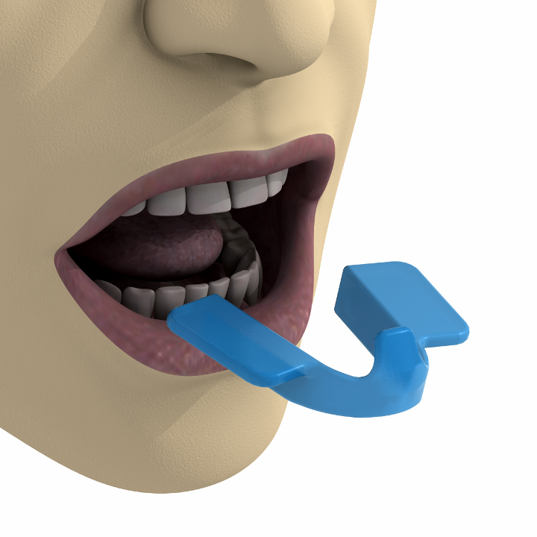
Notes:
The device is placed within the mouth, behind the lower dental arch

Slide 2
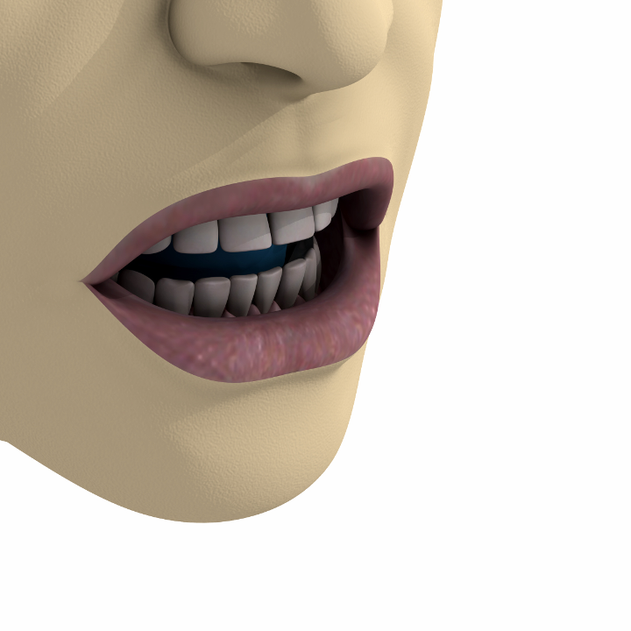
Notes:
And the lateral bite plane should cover inferior premolars and molars

Slide 3

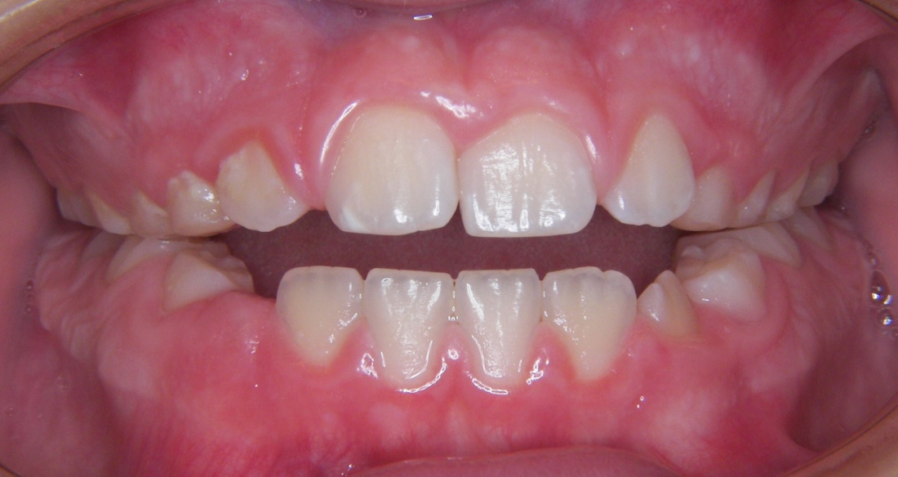
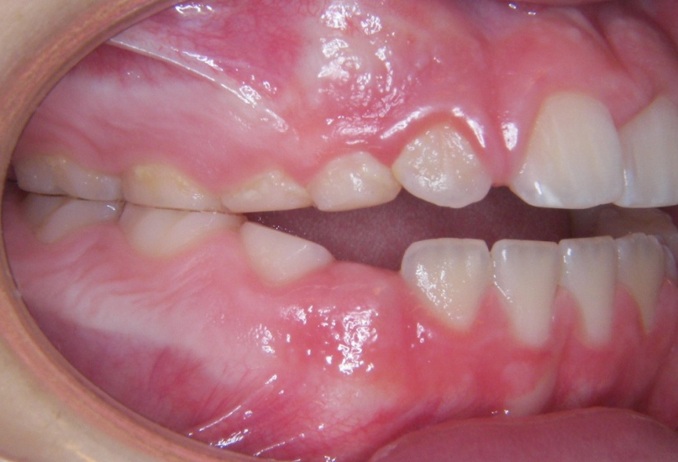
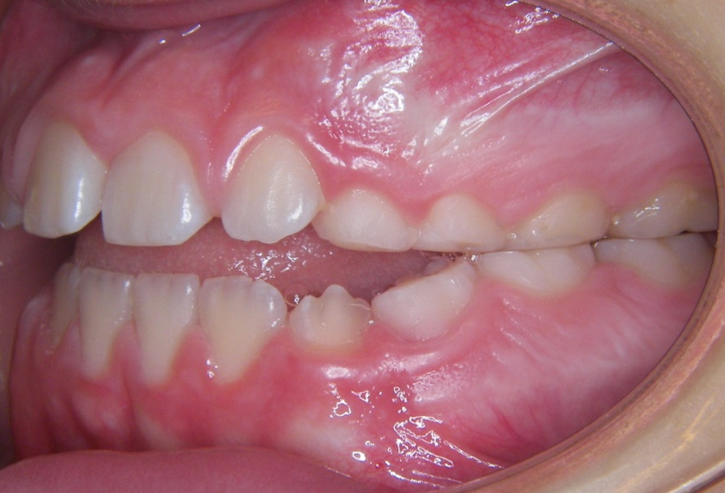
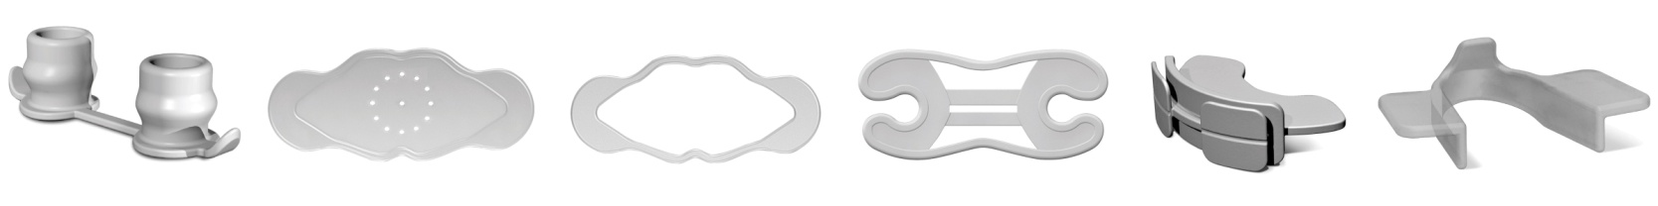
February - 2009
Notes:
It is very easy to place and is very comfortable to wear

Slide 4
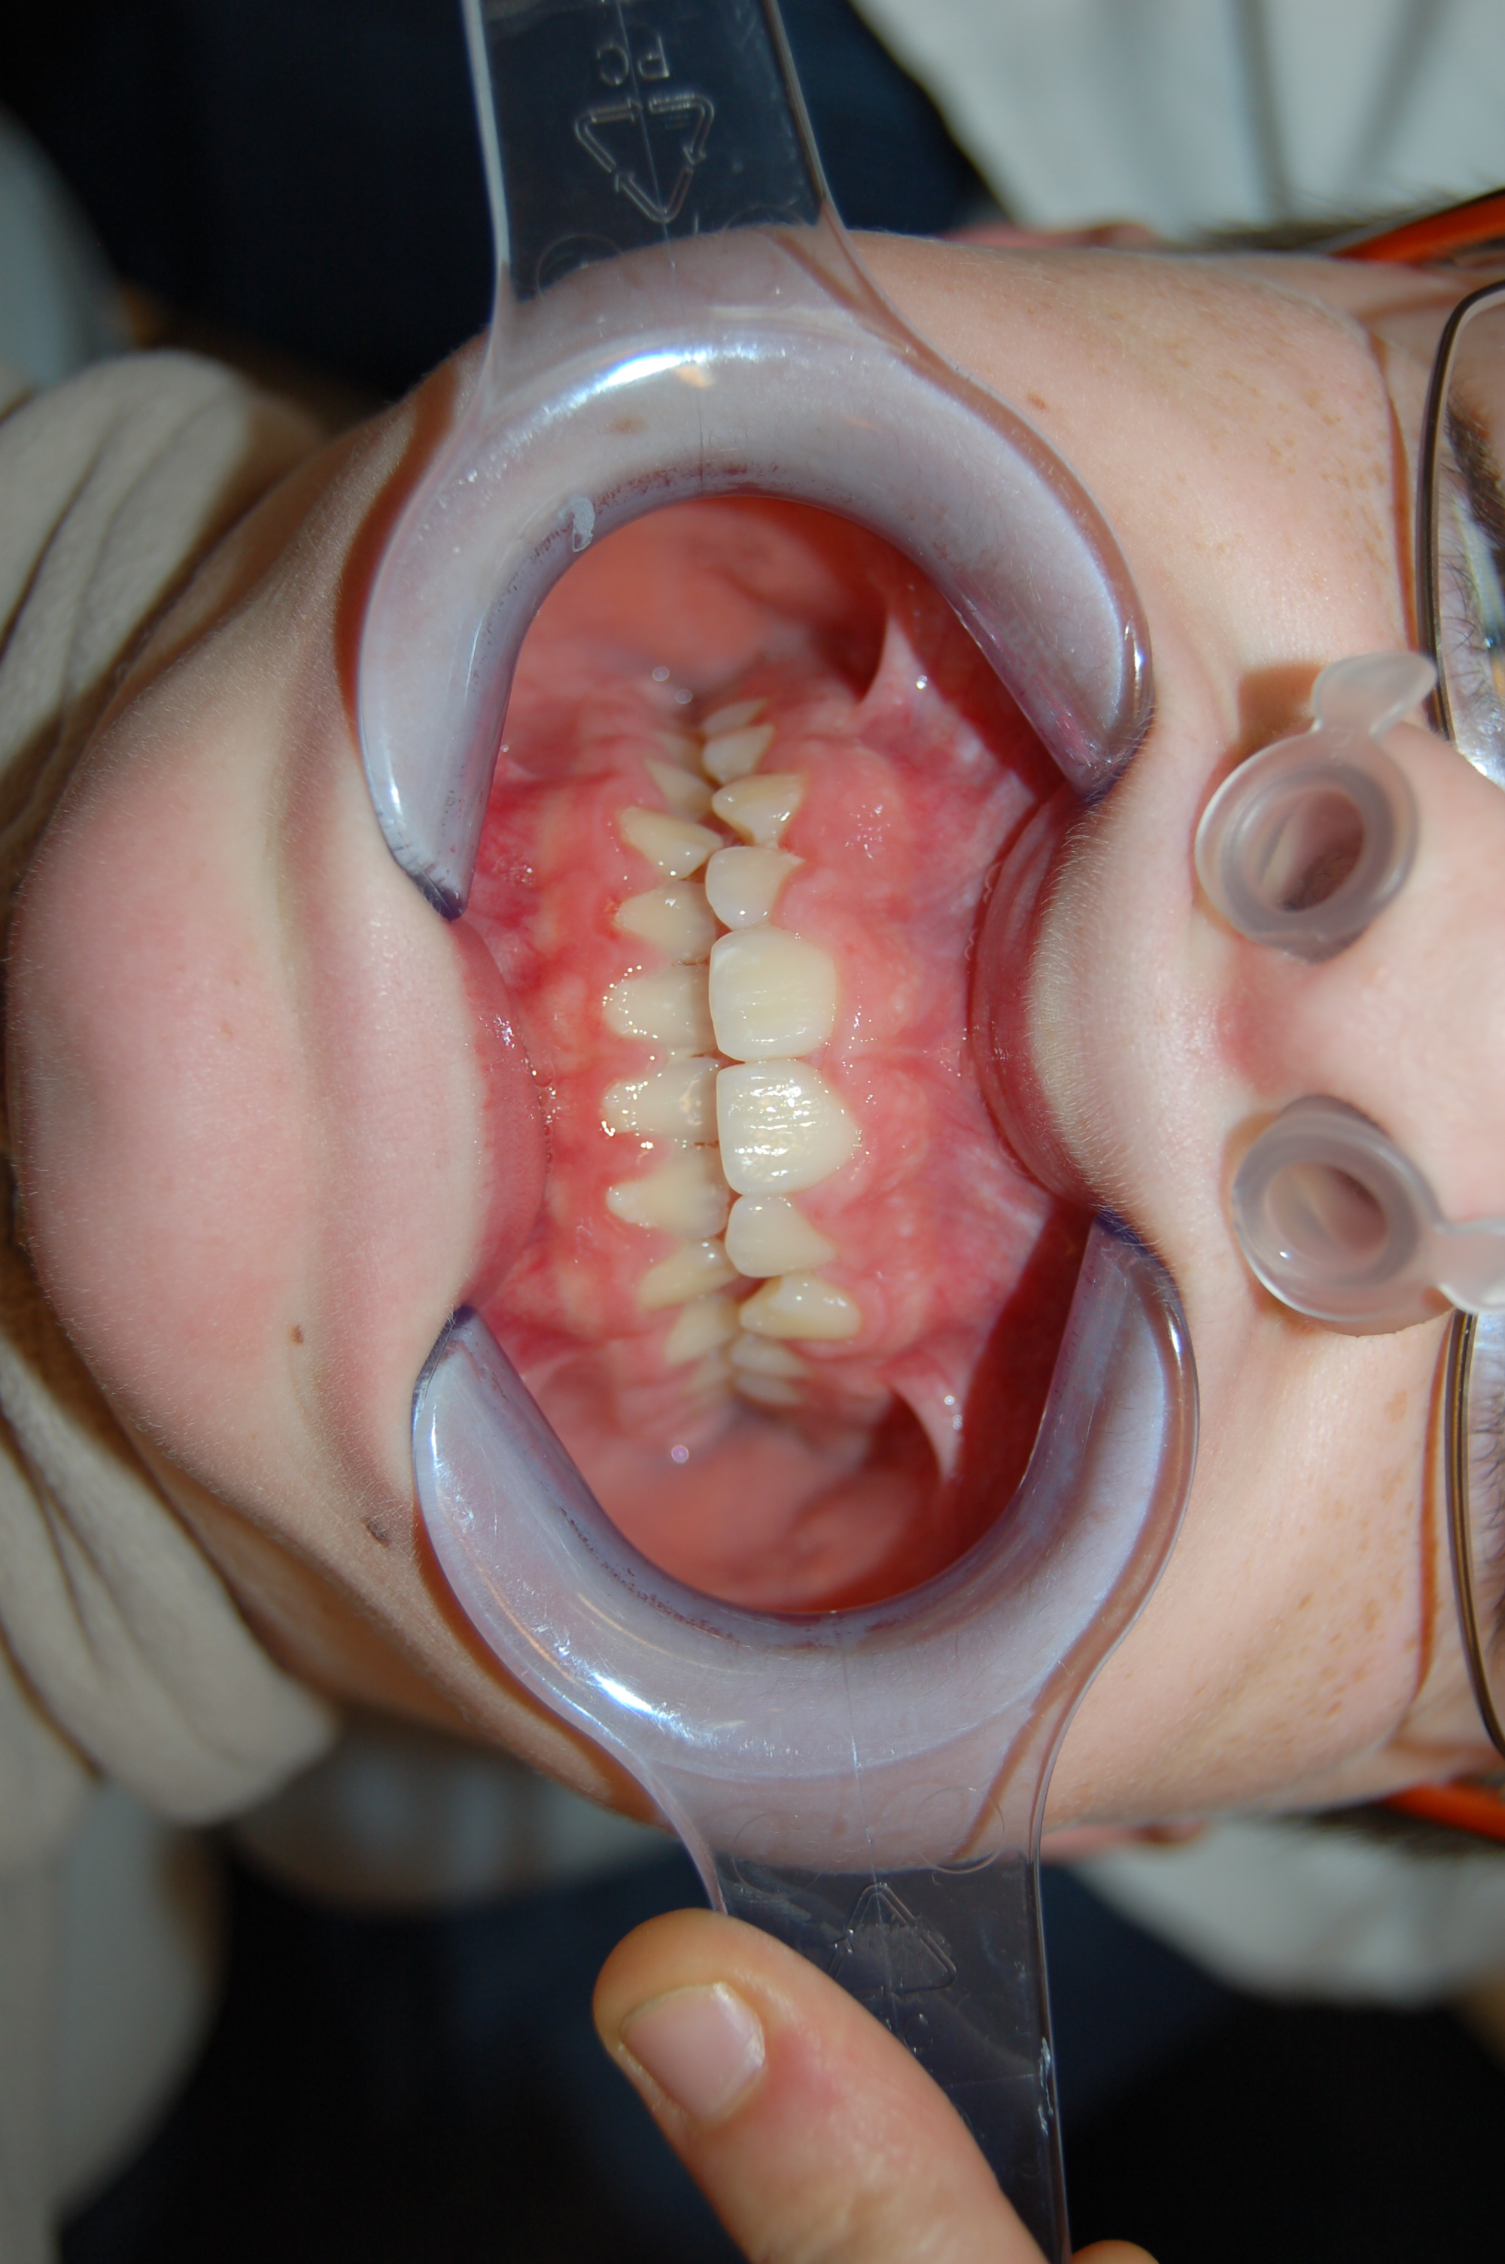
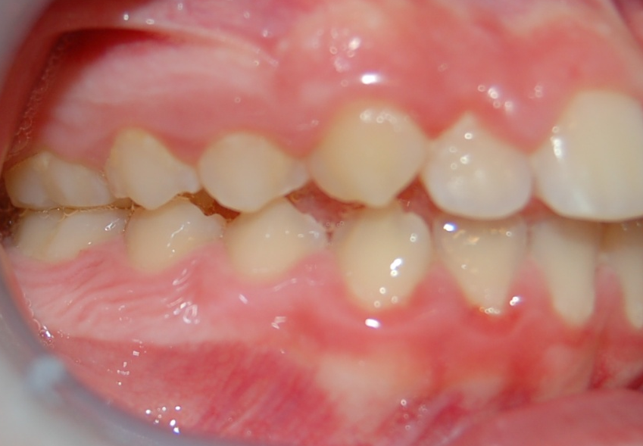
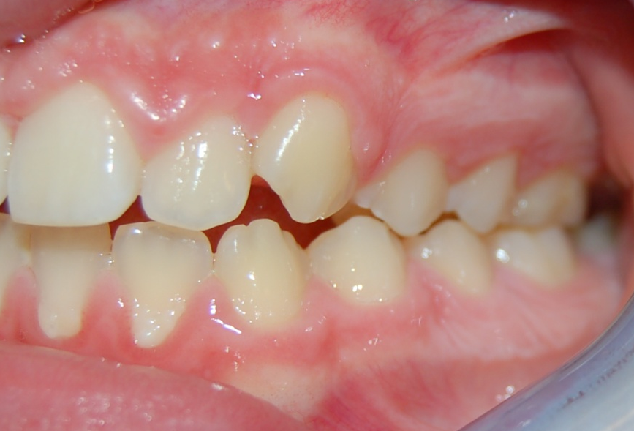
January - 2011
Notes:
It is very easy to place and is very comfortable to wear

Slide 5
Open bite reduction with OB device use
 | N | Minimum | Maximun | Mean | Dev.
Age | 22 | 7 | 9 | 8,00 | 0,816
Initial bite | 22 | 2,0 | 4,0 | 3,432 | 0,470
After 6 months | 22 | 0,5 | 3,5 | 2,182 | 0,628
Results | Mean
Open bite reduction | 1,25 mm
Notes:
Let see this study with 22 patients between 7 to 9 years old were selected, with an anterior open bite minimum of 2 mm and maximum of 4 mm and after 6 month of treatment the mean results where 1,25mm of reduction

